Slide 1
Prédiction du prix des maisons
Github: https://github.com/clauabad/molps-ia-project.git
POUR INSTALLER : LIRE README FILE ON GITHUB
À PARTIR DES DONNÉES HISTORIQUES PREDIRE LE PRIX DES MAISONS
APPRENTISSAGE SUPERVISÉ REGRESSION
CLAUDIA ABAD

Slide 2
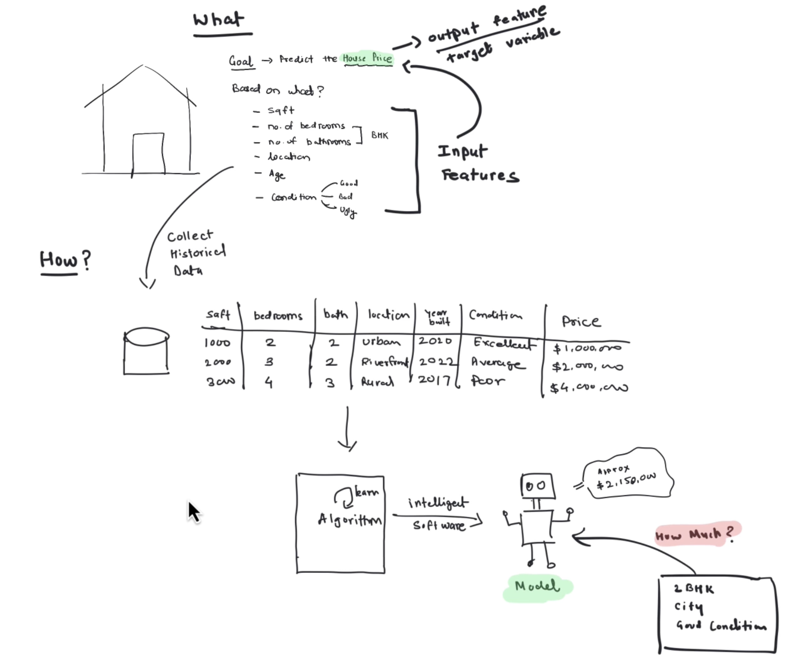
Quoi ? Comment?

Slide 3
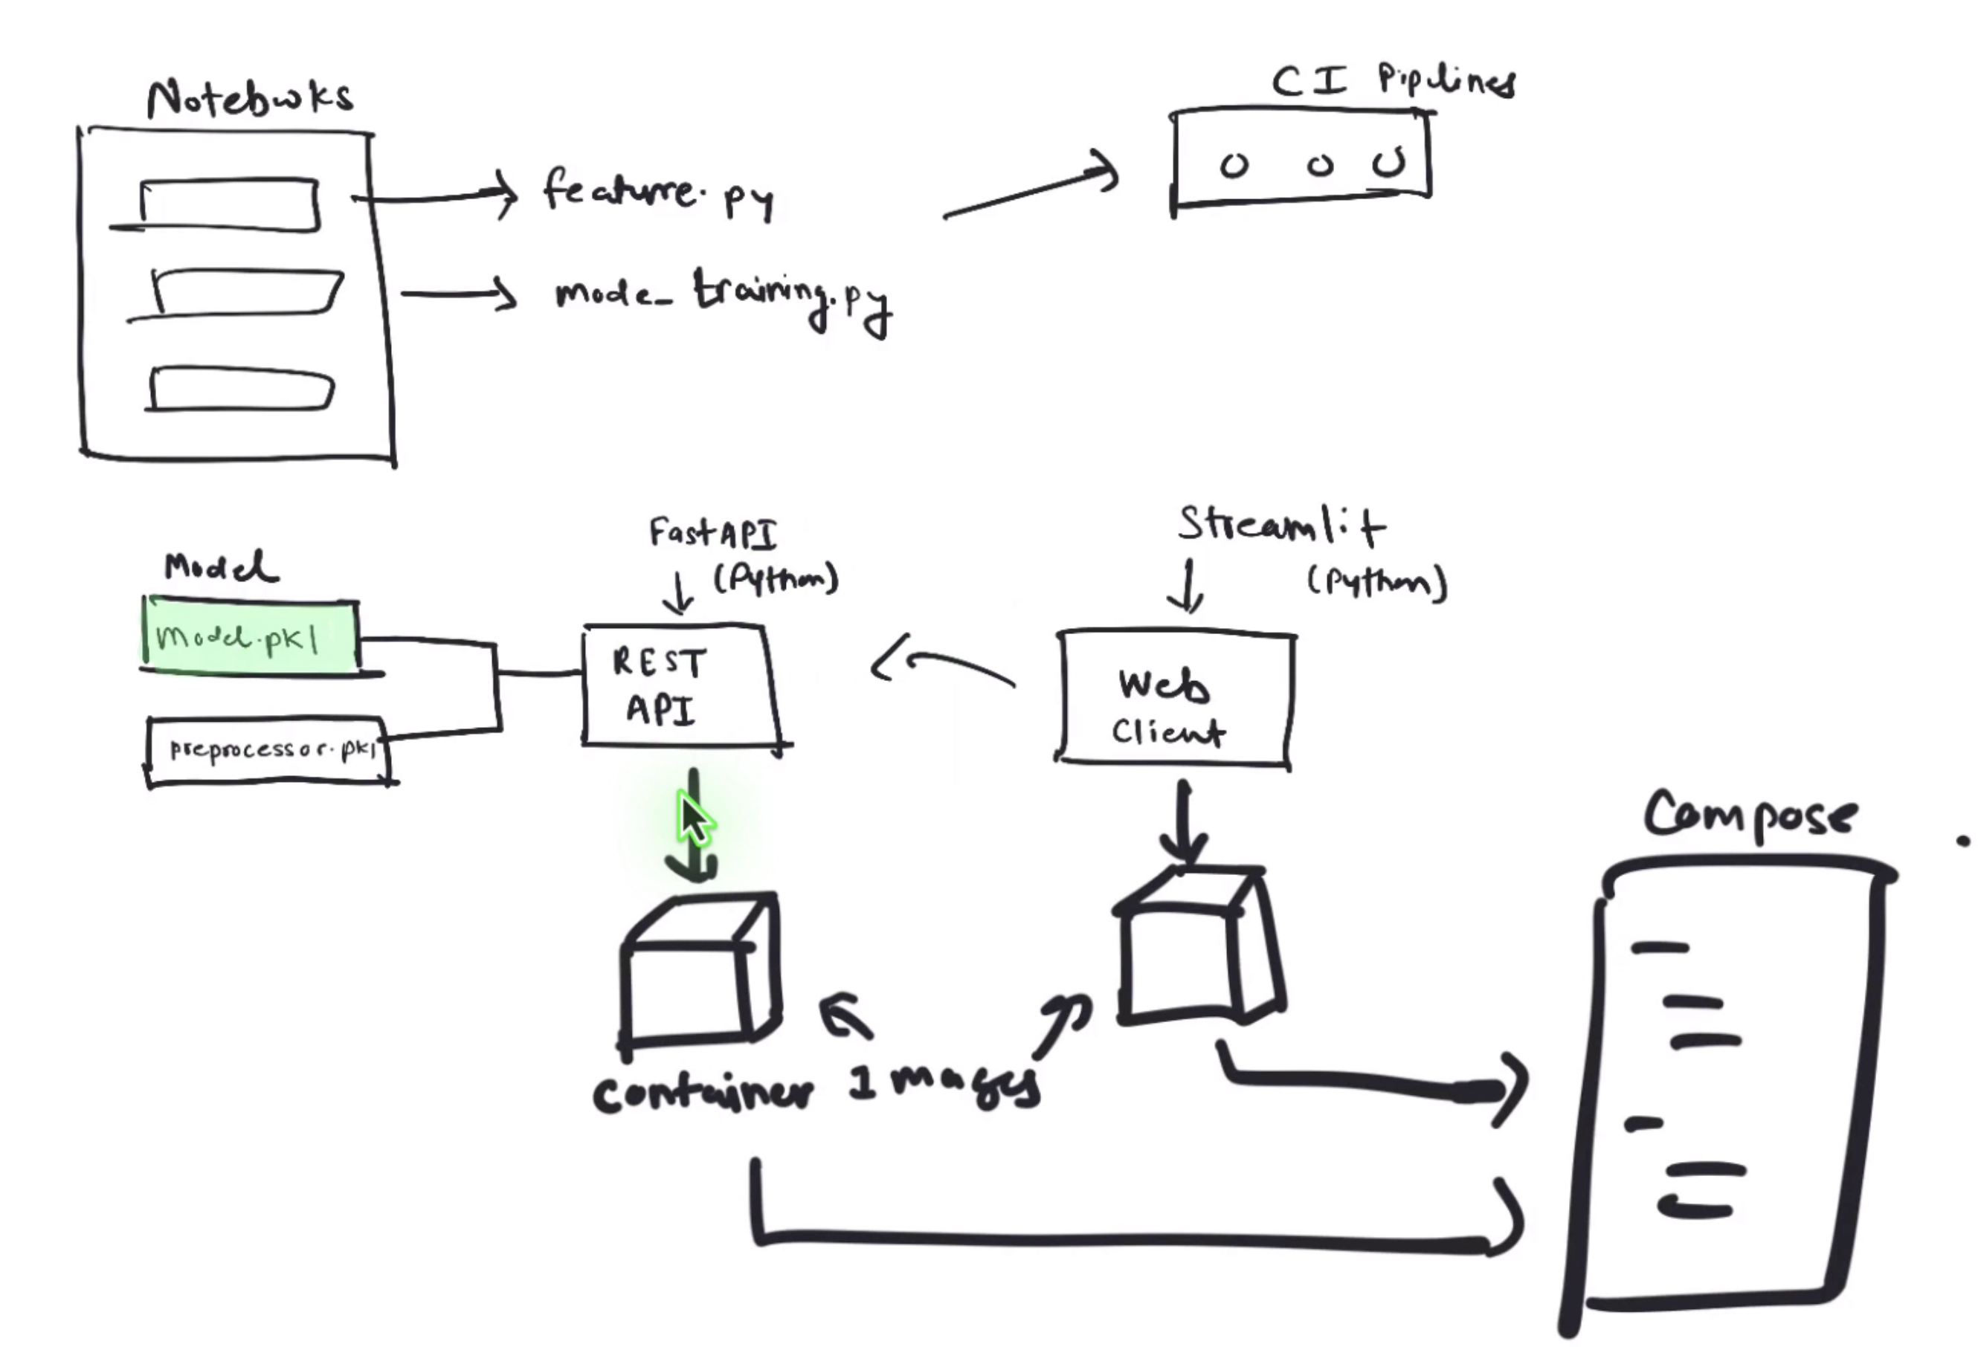

Slide 4
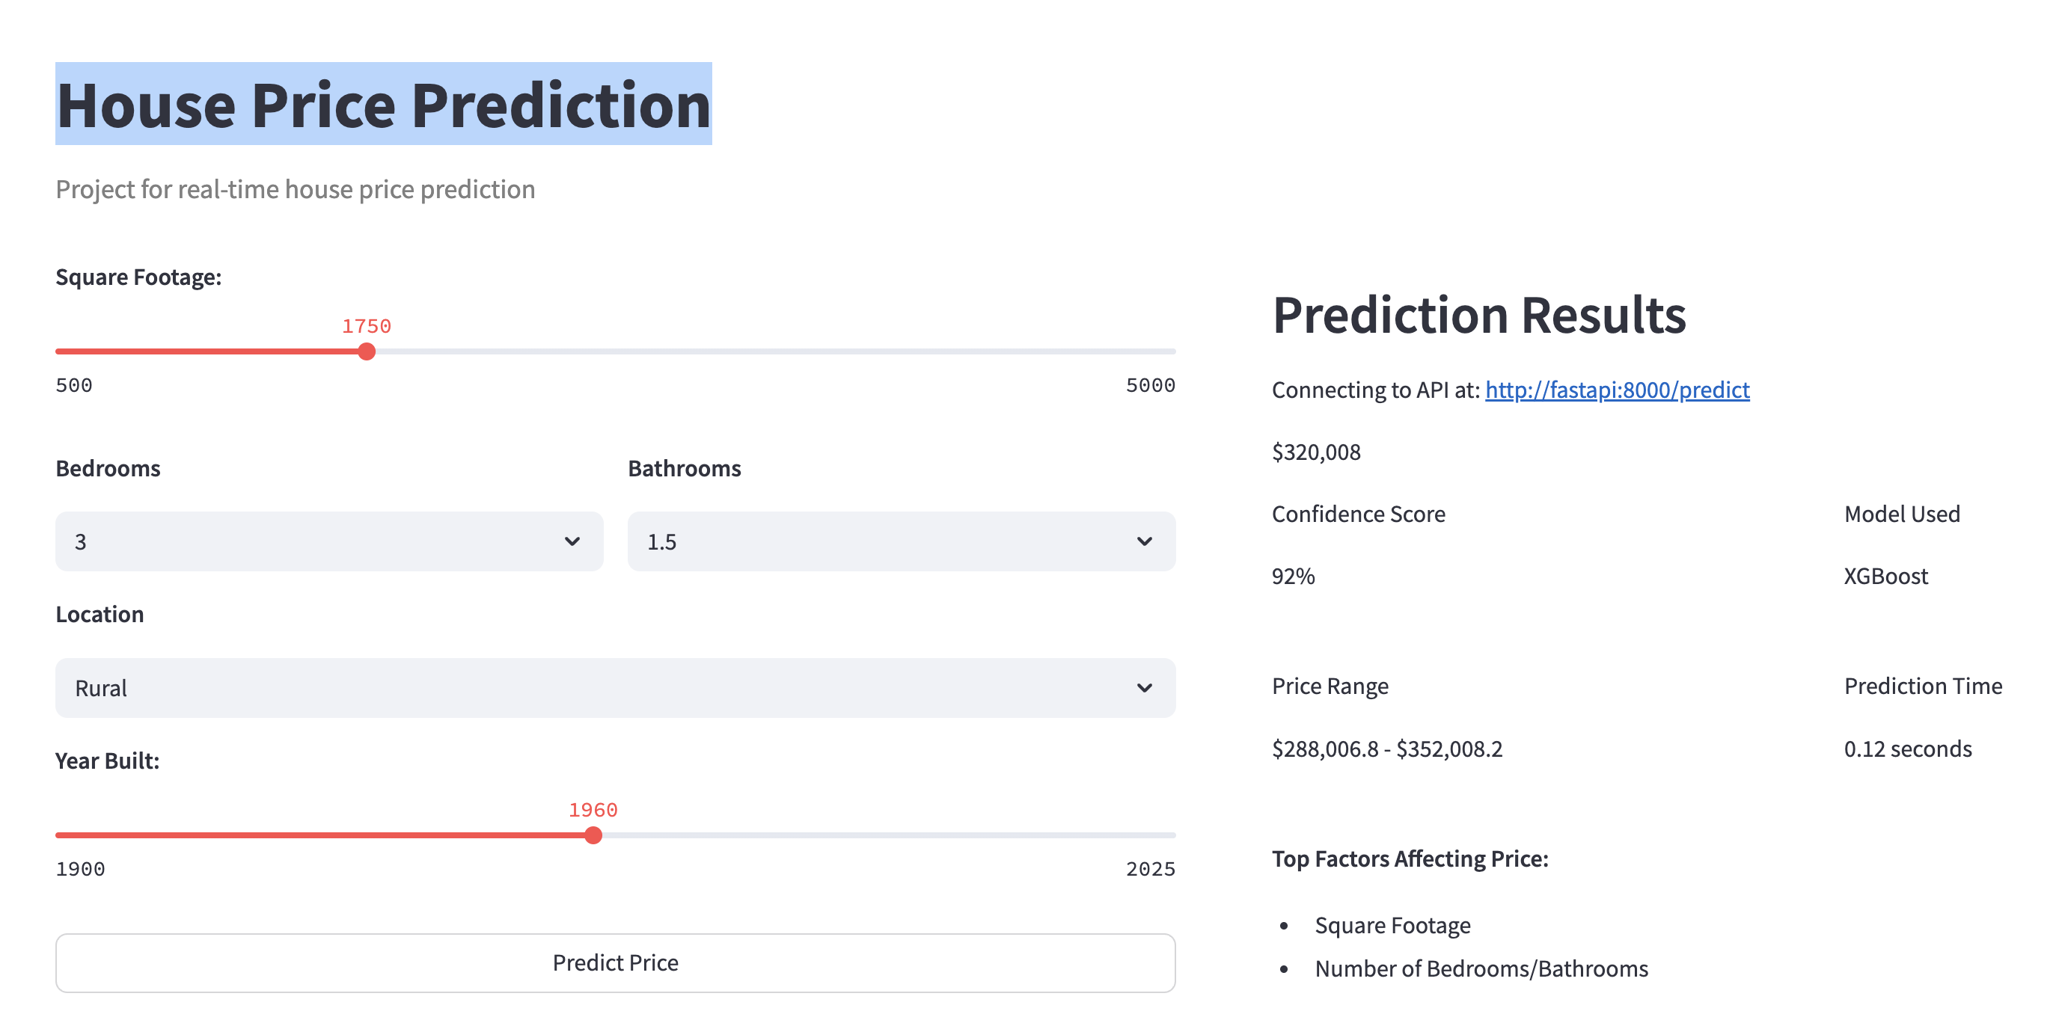
Streamlit UI

Slide 5
FASTAPI
# Health check endpoint
@app.get("/health", response_model=dict)
async def health_check():
return {"status": "healthy", "model_loaded": True}
# Prediction endpoint
@app.post("/predict", response_model=PredictionResponse)
async def predict(request: HousePredictionRequest):
return predict_price(request)
# Batch prediction endpoint
@app.post("/batch-predict", response_model=list)
async def batch_predict_endpoint(requests: list[HousePredictionRequest]):
return batch_predict(requests)

Slide 6
Structure du projet
│ ├── 02_feature_engineering.ipynb
│ └── 03_experimentation.ipynb
├── README.md
├── requirements.txt
├── src
│ ├── api
│ ├── data
│ ├── features
│ └── models
└── streamlit_app
├── app.py
├── Dockerfile
├── README.md
└── requirements.txt
├── configs
│ └── model_config.yaml
├── data
│ ├── interim
│ ├── processed
│ └── raw
├── deployment
│ └── mlflow
├── docker-compose.yaml
├── Dockerfile
├── models
│ └── trained
├── notebooks
│ ├── 00_data_engineering.ipynb
│ ├── 01_exploratory_data_analysis.ipynb

Slide 7
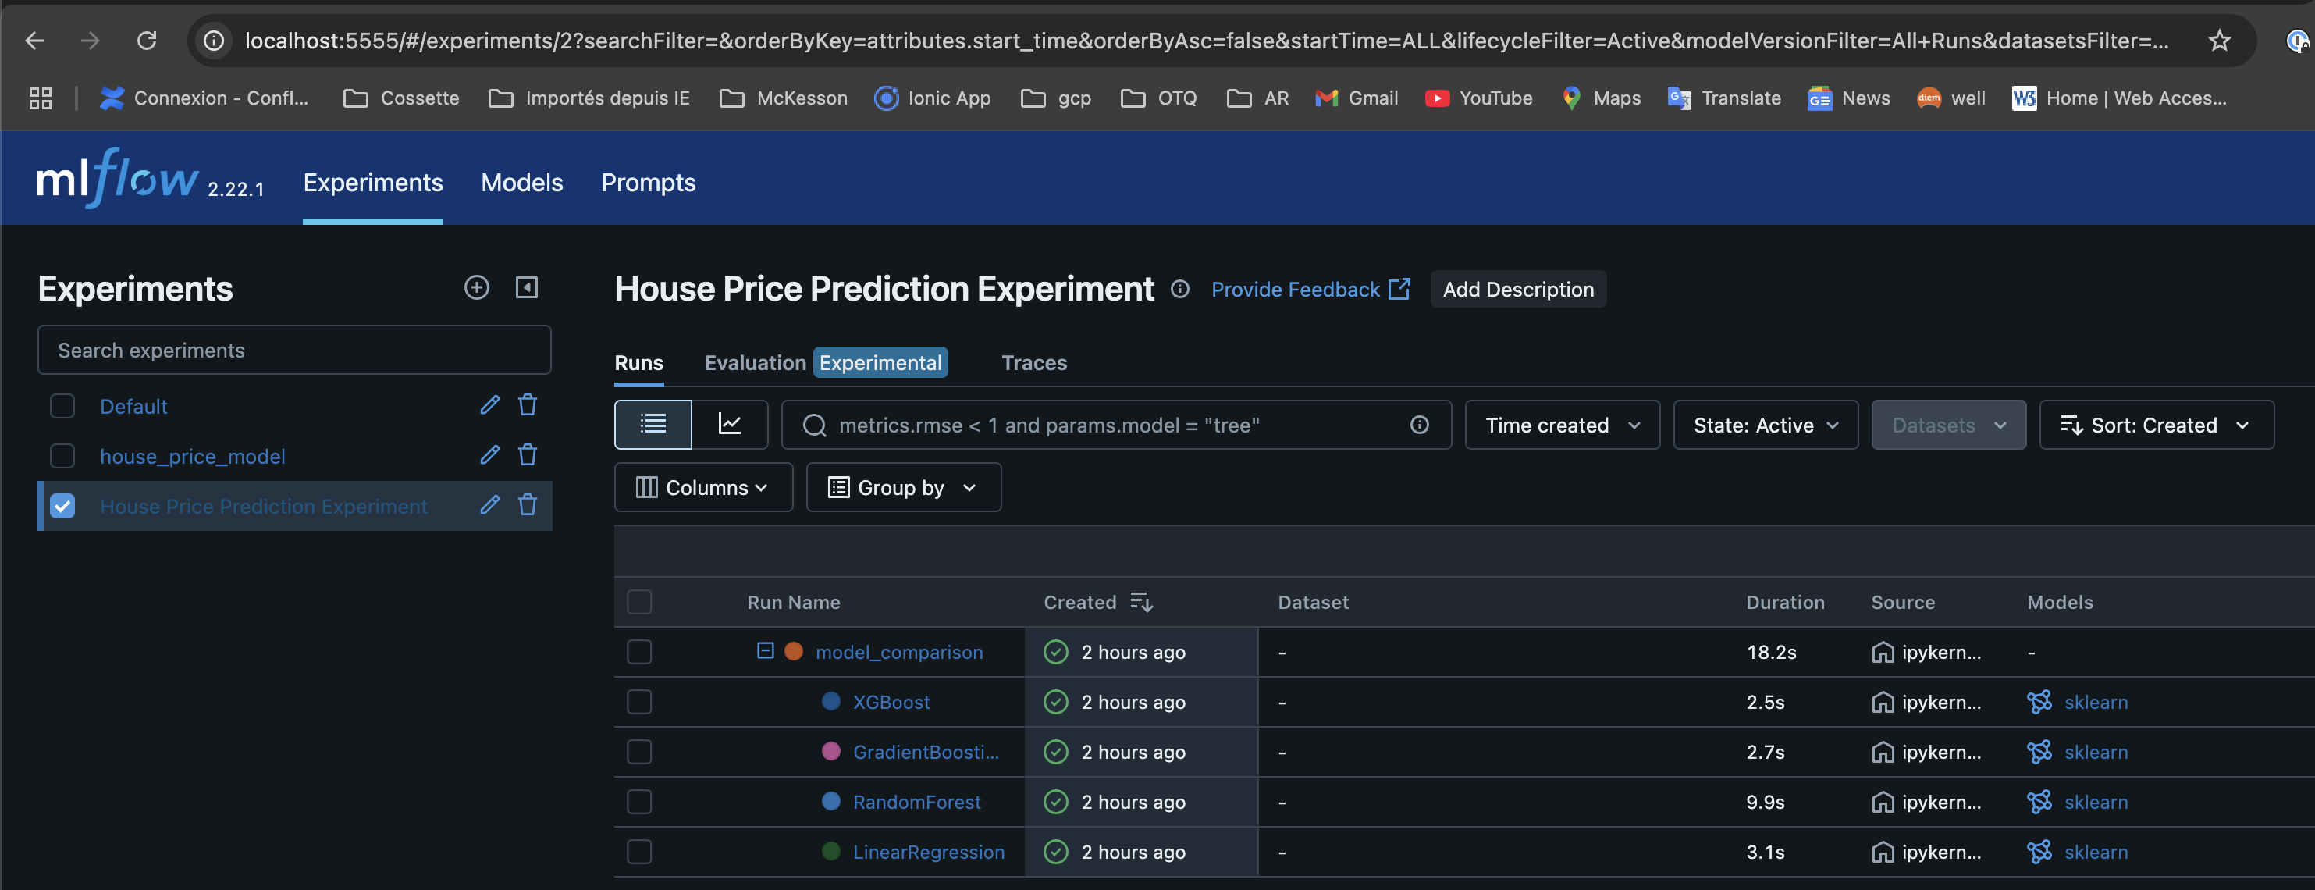
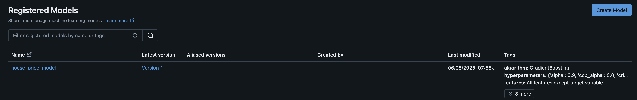
Mlflow

Slide 8
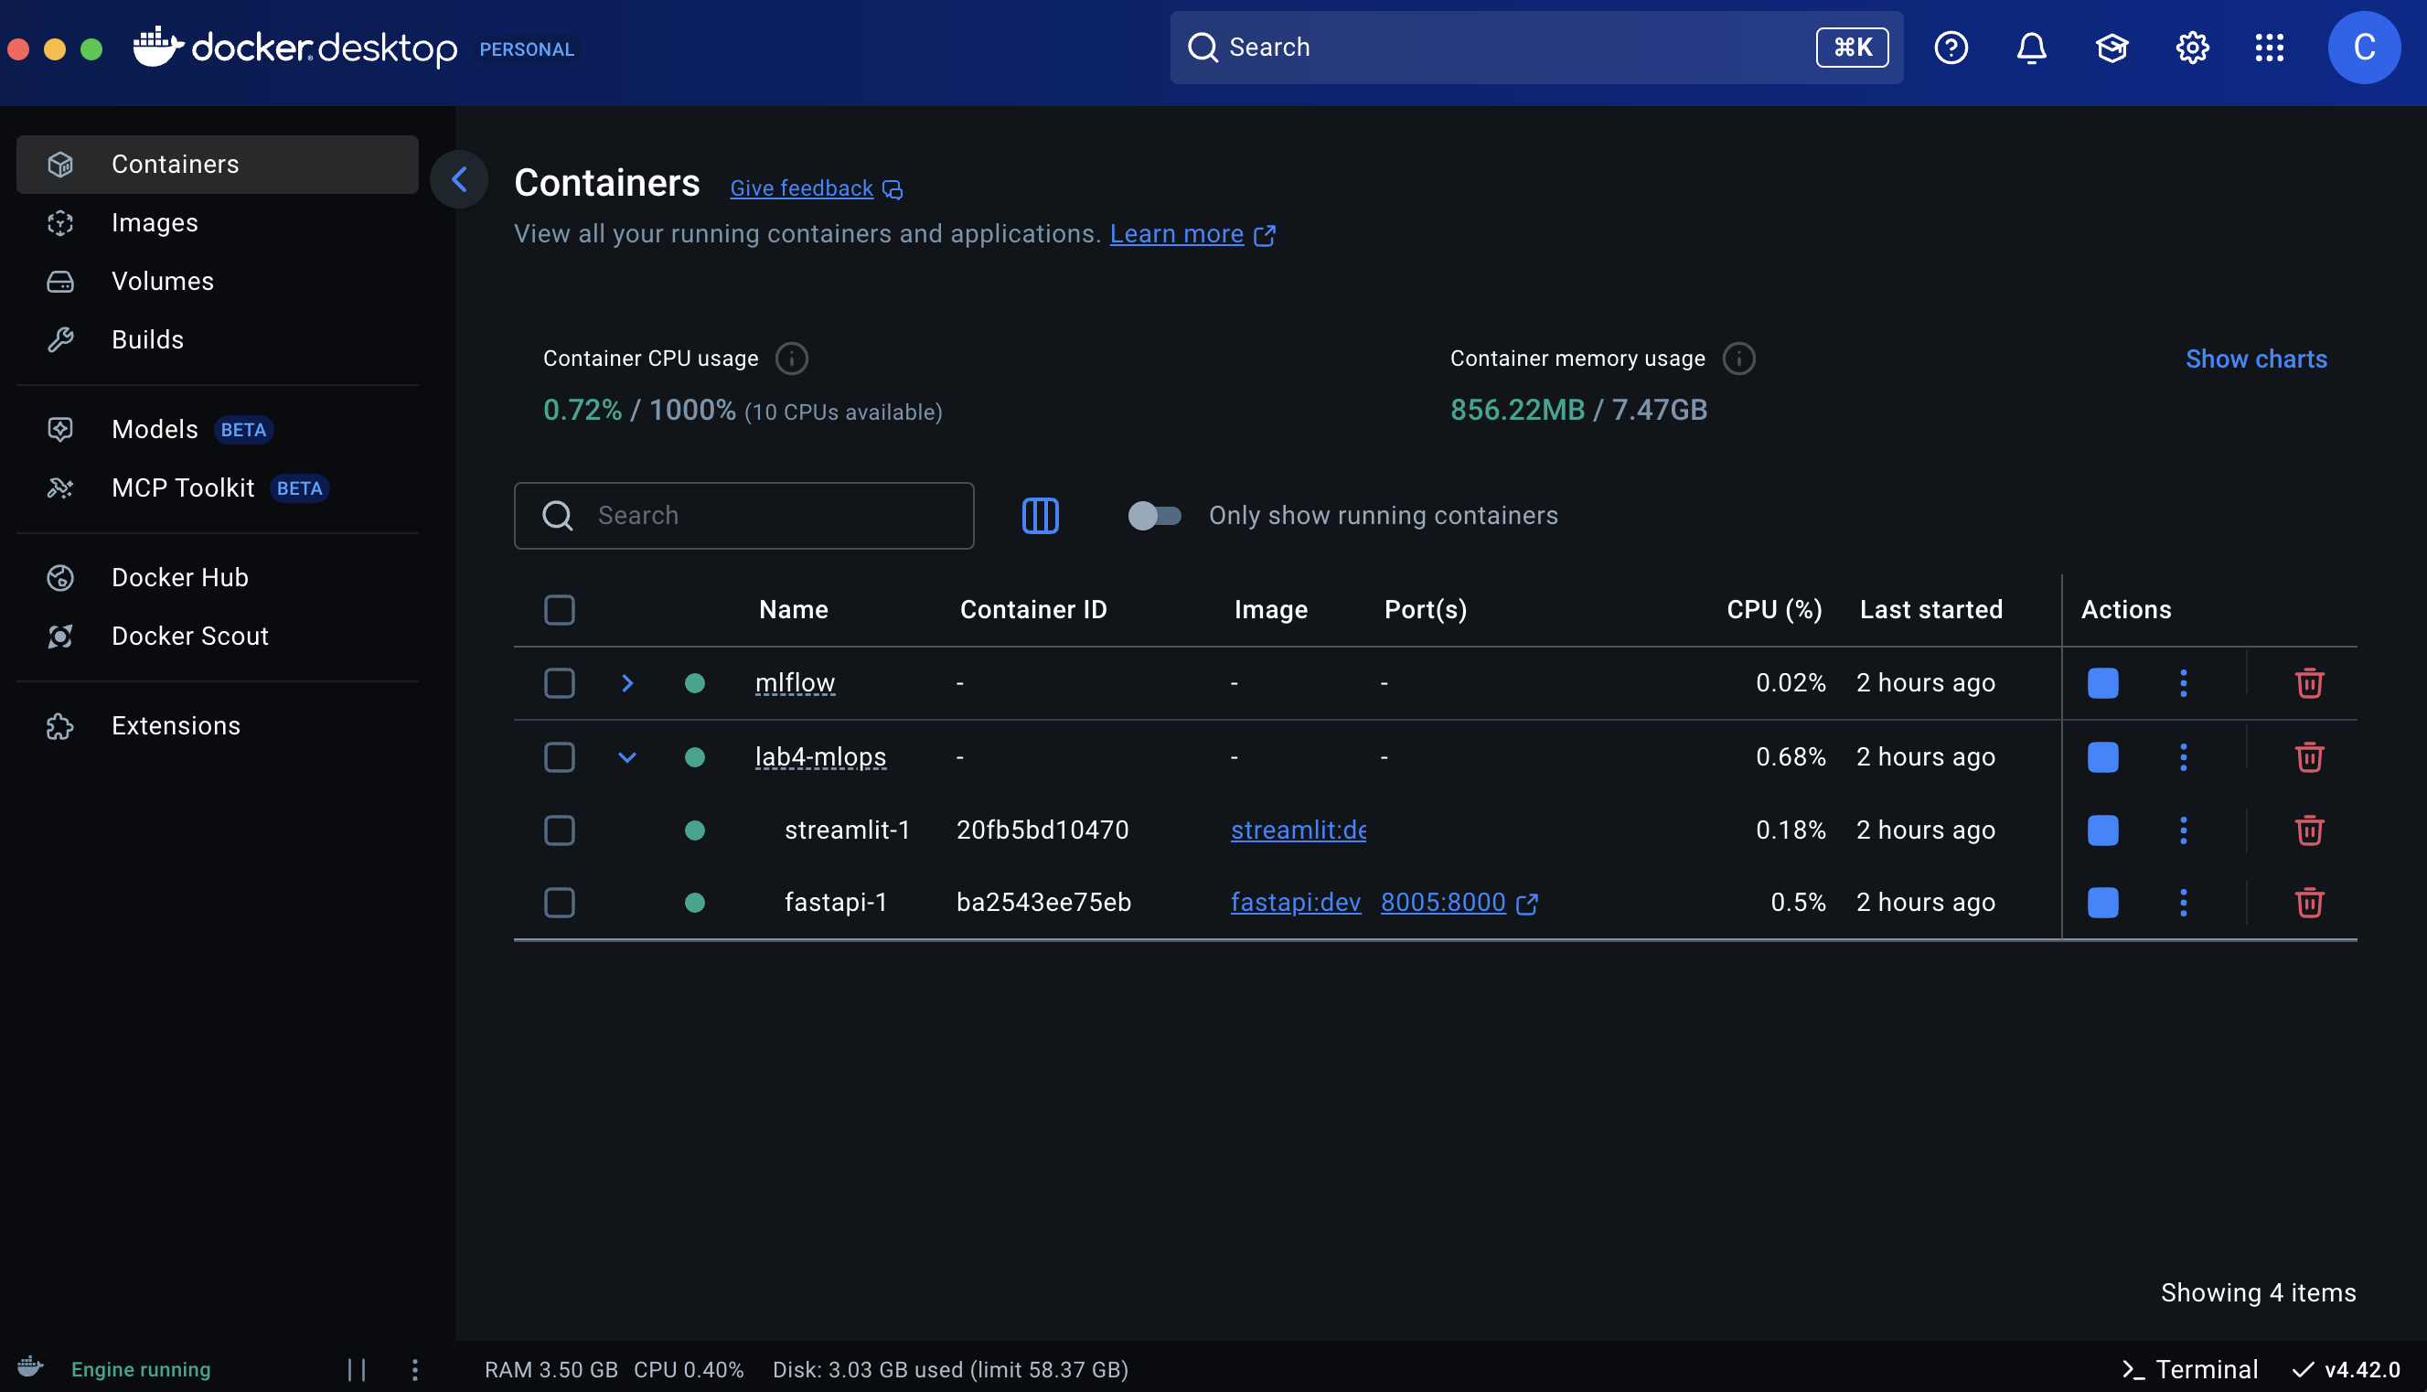
Containers

